Slide 1

AI-Powered Fleet Optimization & Road Incident Prediction for Smart Transportation
Internship Project : Flipkart Pvt Ltd
Domain: AI & Machine Learning
Presented by: Roja Pasupuleti

Slide 2
Project Objective
Develop an end-to-end AI/ML system that:
Predicts potential route incidents
Optimizes fleet scheduling in real time
Automatically re-routes vehicles during disruptions
Designed for large-scale logistics companies

Slide 3
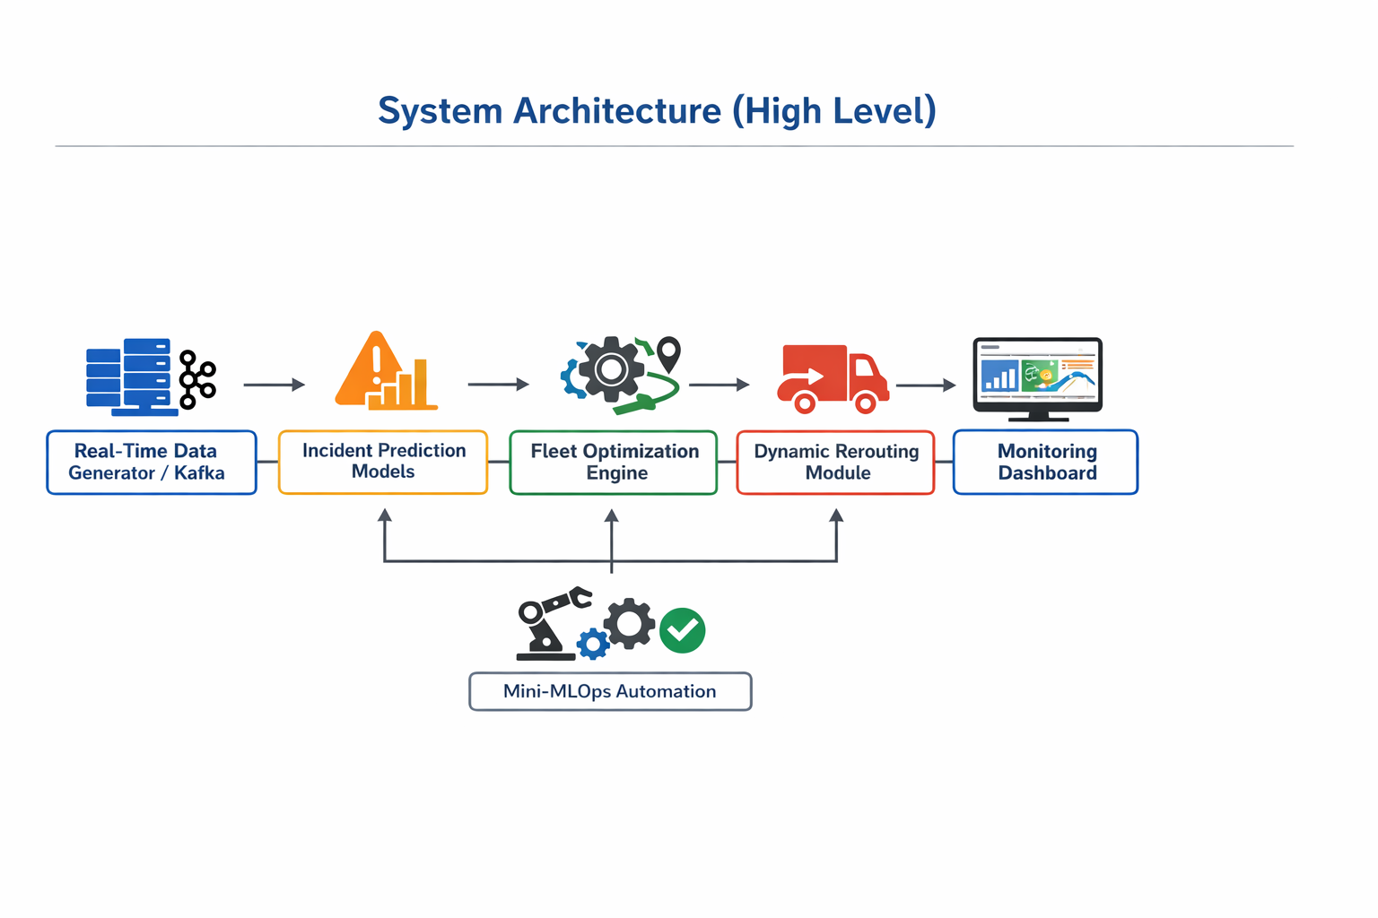
System Architecture
Incident Prediction Models
Fleet Optimization Engine
Dynamic Rerouting Module
Monitoring Dashboard
Real-Time Data Generator / Kafka
Mini-MLOps Automation

Slide 4
Real-Time Data Integration Layer
Simulates live fleet telemetry data
GPS, speed, engine health, driver behavior
Traffic, weather & historical accident risk
Python-based real-time data generator (Kafka alternative)
Provides continuous input to ML models & dashboard

Slide 5
Incident Prediction System
Predicts accidents, breakdowns, slowdowns & route blockages
Models: Random Forest, XGBoost, CatBoost, LSTM/GRU
Uses real-time fleet, traffic, weather & driver behavior data
Ensemble + sequence learning for higher accuracy
Evaluated using Precision, Recall, F1, ROC-AUC
False Negative Rate minimized to prioritize safety

Slide 6
Fleet Scheduling Optimization
Optimizes vehicle-to-task assignment in real time
Uses Genetic Algorithm (VRP-based optimization)
Considers: capacity, driver shifts, traffic & time windows
Integrates Phase-2 risk scores into cost function
Minimizes fuel cost, delivery delay & idle time
Flags high-risk vehicles for rerouting

Slide 7
Dynamic Rerouting System
Identifies safest & fastest alternate routes
Automatically reroutes high-risk vehicles flagged by optimization engine
Dynamically updates ETA and destination
Logs rerouting events for monitoring & analysis
Uses OSRM / OpenRouteService with Folium for route visualization

Slide 8
Monitoring Dashboard
Live GPS tracking & interactive route maps
Real-time incident risk scores and alerts
Traffic heatmaps to identify congestion zones
Real-time fleet visibility via Streamlit dashboard
Fleet utilization & fuel consumption forecasts
Driver behavior alerts for proactive intervention

Slide 9
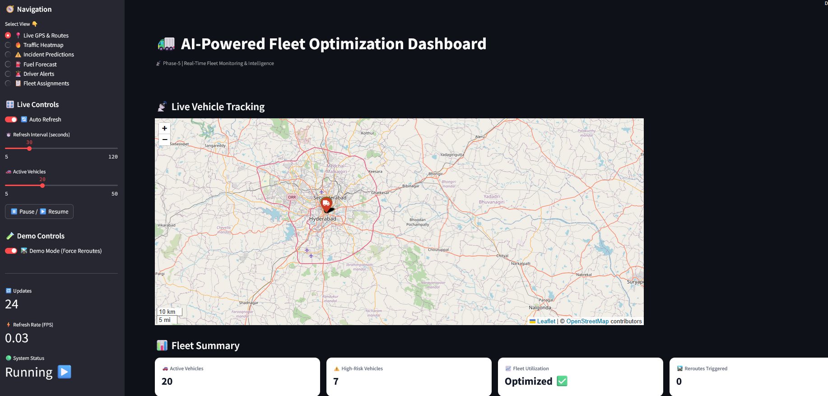
Output Screen

Slide 10
Tools & Libraries
🐍 Python Ecosystem: Python, pandas, numpy 🤖 Machine Learning: Scikit-learn, XGBoost, CatBoost,TensorFlow 🗺 Geospatial: Geopy, Folium 🧮 Optimization: Google OR-Tools (VRP) 📊 Dashboarding: Streamlit / Dash 🔄 Data Streaming: Kafka / Python generators

Slide 11
Conclusion & Impact
Reduced delivery delays
Improved fleet efficiency
Lower fuel consumption
Enhanced driver safety
Scalable enterprise-level solution
Applicable to: Flipkart, Amazon, Uber Freight

Slide 12

Thank you

